Slide 1


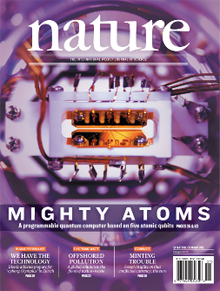
Quantum machine learning with Trapped Ions
Norbert M. Linke
TIQI group, Chris Monroe
JQI, UMD
QML workshop, 27th Oct. 2018, College Park, MD

Slide 2
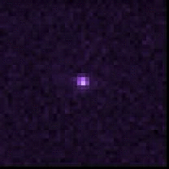
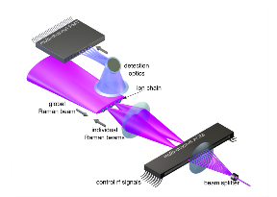
Overview
Quantum computing
system
why ions make good qubits
Quantum computer module
hardware (5-7 qubits)
modular gates and compiler
Quantum machine learning applications
Learning qubit readout
Deuteron nucleus
Bars and Stripes
QAOA
Outlook: Scaling up

Slide 3
Trapped ions
A good quantum computing candidate – why?
|
1〉
|
1〉
|
0〉
|
0〉
laser
+
+
detector
Isolated quantum system, preparation and read-out with laser light
gate operations (using lasers/microwaves)
Notes:
Plant the idea of gates (i.e. conditional operation) using the motion
Accessible from the outside, yet undisturbed – a paradox

Slide 4
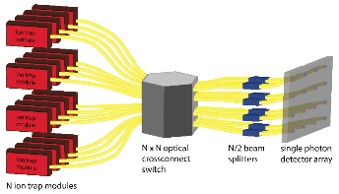
The ion trap quantum computer (vision)
Ion trap Quantum computing – the big pic
segmented electrodes
“accumulator”
quantum register
D. J. Wineland et al. 1998
C. Monroe / J. Kim et al. 2013
Are we there yet…? – challenges
Higher fidelity operations
Scalability: control over more qubits
Notes:
each operation is subject to error - correcting errors requires additional resources and operations - errors must be below (10⁻²-10⁻⁴ per operation to begin with)
microfabricate devices, control over more quantum systems - integrate control elements - use new scalable approaches to control (microwaves)
let the Musiqc play!

Slide 5
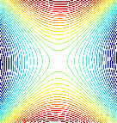
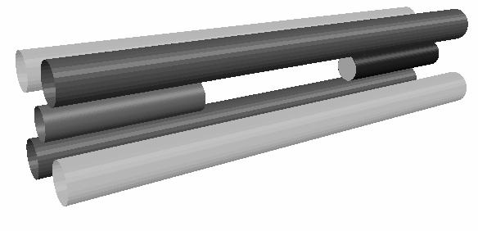
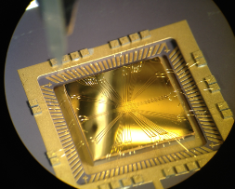
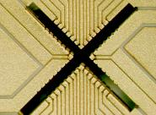
Ion traps (reality)
The linear Paul trap – dynamic confinement in electric RF quadrupole + DC potential
+
-
-
+
+
Microfabricated versions – miniaturized 3D traps / surface traps
500 um
MAT (Oxford)
Microtrap (Oxford, Innsbruck, Mainz et al.), 2008
Wolfgang Paul (Nobel Prize 1989)
D.P.L. Aude Craik et al., PRA 95 (2017)
Notes:
RF potential (~30MHz) for dynamic radial confinement
DC potential for axial static confinement
traps typically operated at room temperature under UHV
photo-ionization of atoms inside trapping potential
laser beams for cooling, observation, operations
Mention NIST 3D trap with bridge junction!

Slide 6
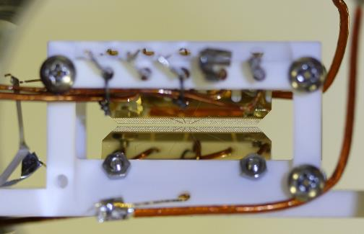
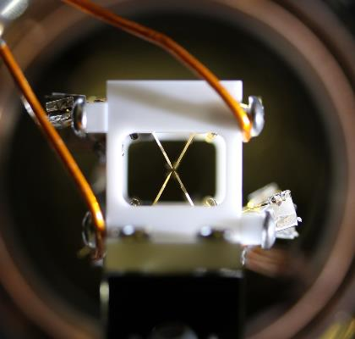










Ion traps: hardware in current UMD module
trapped ion Coulomb crystals

Slide 7


Trapped ion qubits: ¹⁷¹Yb⁺ level structure
atomic clock qubit -> B-field insensitive
long coherence times: ~1s
S. Olmschenk, et al., PRA 76 (2007)

Slide 8

Trapped ion qubits: State initialization
²P_{1/2}
F=1
F=0
369 nm
F=1
²S_{1/2}
12.6 GHz
F=0
Notes:
So why are these ion chains so great? Essentially, they’ve already been proven to satisfy the basic requirements of a quantum computer. The qubit state, which is encoded in the ground state hyperfine levels, can be initialized to any point on the Bloch sphere with extremely high fidelity. Optical pumping prepares the qubit in a pure “down” state, and doppler and sideband cooling can prepare the motional ground state as well.

Slide 9
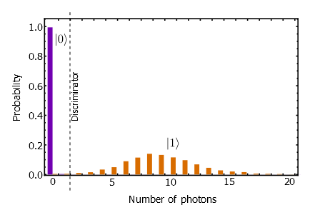


Trapped ion qubits: State detection
²P_{1/2}
F=1
2.1 GHz
F=0
369 nm
F=1
²S_{1/2}
12.6 GHz
F=0
Notes:
Readout of the qubit state is very clean and efficient. Resonant fluorescence at 369nm on the “up” state is 12 GHz away from the “down” state resonance, and the scatter rate is high enough to yield well-distinguished up/down Poissonian distributions within 500us. Furthermore, our use of multi-channel PMTs and ICCDs allow us to detection individual spin states for precise ion chain state detection.

Slide 10
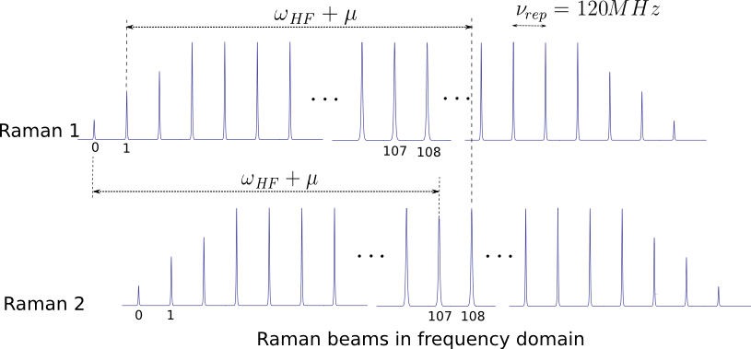
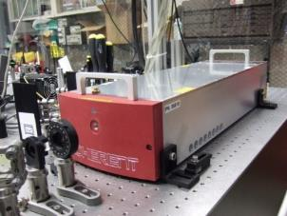
¹⁷¹Yb⁺ as a qubit: coherent manipulation
stimulated Raman transitions using pulsed 355nm
²P_{3/2}
100 THz
Δ=66 THz
²P_{1/2}
Δ=33 THz
355 nm
|1⟩
²S_{1/2}
|0⟩

Slide 11
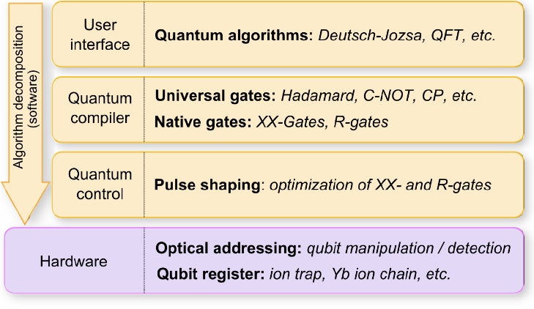

Modular architecture
Grover, Hidden Shift, EC …
S. Debnath et al. Nature 536 (2016)

Slide 12
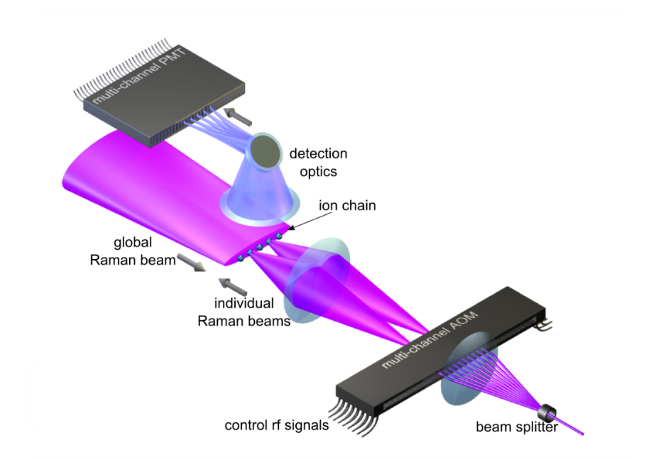
Hardware
¹⁷¹Yb⁺
²P_{3/2}
Δ=66 THz
²P_{1/2}
Δ=33 THz
355 nm
|1⟩
²S_{1/2}
|0⟩

Slide 13
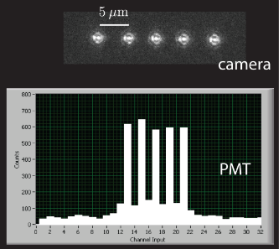
Hardware: Read-out

Slide 14
Modular architecture
Grover, Hidden Shift, EC …
S. Debnath et al. Nature 536 (2016)

Slide 15
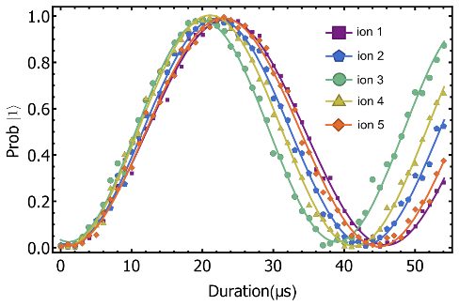


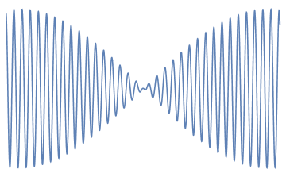
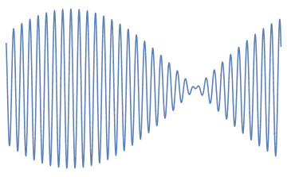
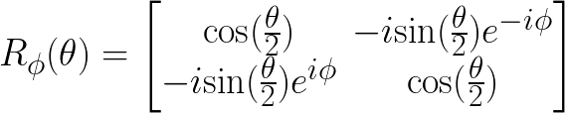
Quantum control: Single qubit rotations
Raman beat note
R-gate

Slide 16
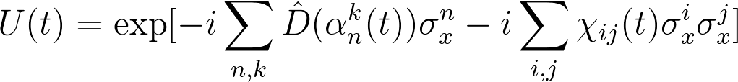
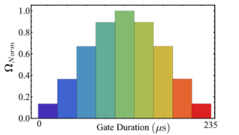



Quantum control: Exciting the motion
mode1
mode2
…
carrier
red
sideband
blue
sideband
transition probability
1
5
5
1
Beatnote frequency
K. Mølmer and A. Sørensen, Phys. Rev. Lett. 82 (1999)
S.-L. Zhu et. al., Phys. Rev. Lett. 97 (2006)
T. Choi et al., Phys. Rev. Lett. 112 (2014)

Slide 17
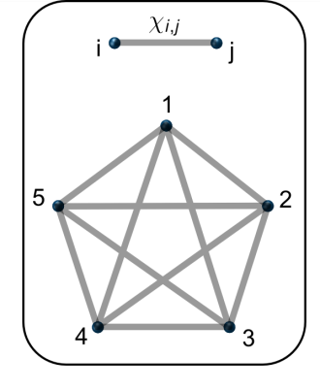
Quantum control: Full connectivity
not limited to local operations
NML et al. PNAS 114, 13 (2017)

Slide 18
Modular architecture
Grover, Hidden Shift, EC …
S. Debnath et al. Nature 536 (2016)

Slide 19
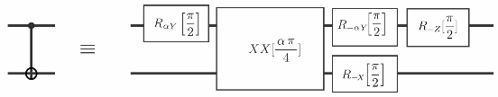

Quantum compiler: Modular CNOT gates

Slide 20
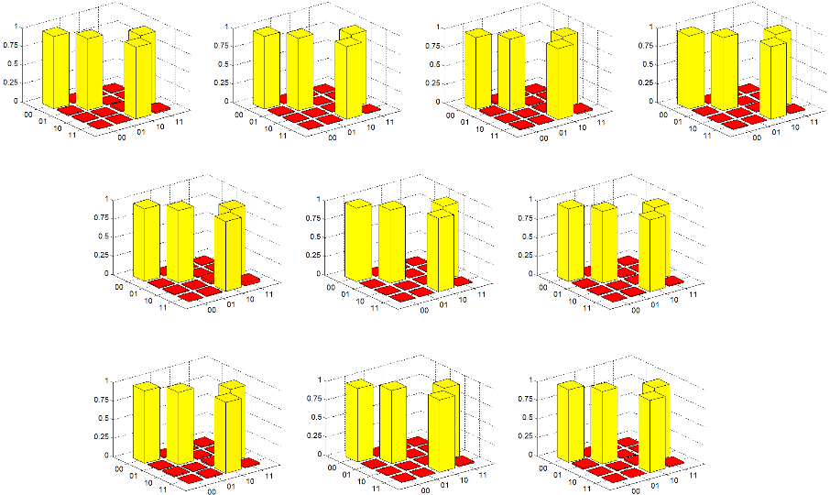
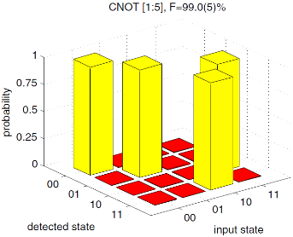

Quantum compiler: Modular CNOT gates
CNOT [1:2] F=96.4(6)%
CNOT [1:3] F=97.6(7)%
CNOT [1:4] F=95.9(7)%
CNOT [1:5] F=97.9(5)%
CNOT [2:3] F=95.6(6)%
CNOT [2:4] F=98.4(7)%
CNOT [2:5] F=96.8(7)%
CNOT [3:5] F=97.6(6)%
CNOT [4:5] F=97.2(5)%
1
CNOT [3:4] F=96.6(5)%
0.8
0.6
0.4
0.2
0
spam reduces this by ~2%

Slide 21
Modular architecture
Grover, Hidden Shift, EC …
S. Debnath et al. Nature 536 (2016)

Slide 22
Quantum algorithms: build it …and they will come!
Quantum Fourier Transform, Bernstein-Vazirani algorithm, Deutsch-Josza algorithm¹
Hidden Shift algorithm² – M. Roetteler (Microsoft)
Grover’s algorithm⁴ – D. Maslov (NSF)
Fault-tolerant quantum error detection³ – K. Brown (Georgia Tech.)
Quantum game theory and Nash equilibria⁵ – N. Solmeyer (Army Research Lab)
Renyi entropy measurement of a Fermi-Hubbard model system⁶ – S. Johri (Intel)
Quantum scrambling and out-of-time-order correlators⁷ – N. Yao (UC Berkeley)
Deuteron VQE – R. Pooser (Oak Ridge)
Quantum machine learning⁸ – A. Ortiz (NASA)
Bacon-Shor quantum error correction codes¹⁰ – T. Yoder (Harvard)
Quantum machine learning^{8,10} – A. Ortiz (NASA)
Neural-network-based qubit readout⁹ – A. Seif (QuiCS/UMD)
…
1 S. Debnath et al. Nature 536 (2016) 2 NML et al., PNAS 114, 13 (2017)
3 NML et al., Sci Adv. 3, 10 (2017) 4 C. Figgatt et al., Nat. Communs. 8, 1918 (2017)
5 N. Solmeyer et al., Q. Sci. Tech. 3 4 (2018) 6 NML et al., arxiv 1712.08581 (2017)
7 K. A. Landsman et al., arxiv 1806.02807 8 M. Benedetti et al., arxiv 1801.07686 (2018)
9 A. Seif et al., J. Phys. B 51 174006 (2018) 10 in preparation

Slide 23
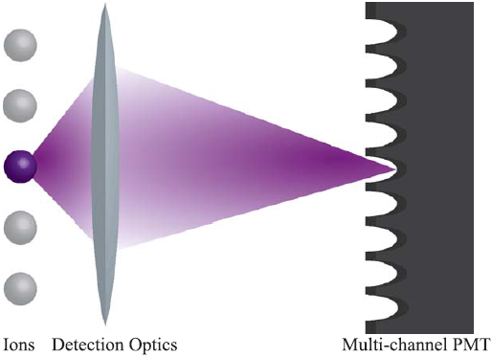
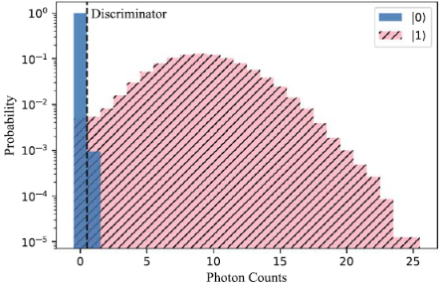
Machine learning for a quantum computer
use ML to reduce readout errors
fixed interrogation time 150us

Slide 24
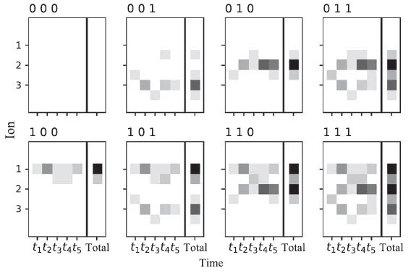
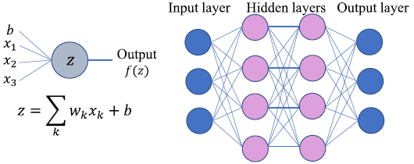
Machine learning based qubit readout
Additional data is available – time-stamping and intermediate channels
How to classify efficiently – an artificial neural net
Notes:
Train by minimizing the cross-entropy between the nodes’ bias b and weight w, using ADADELTA optimizer

Slide 25
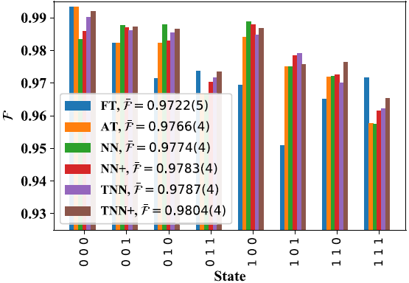
Machine learning based qubit readout
Results – neural net based qubit readout in action

Slide 26
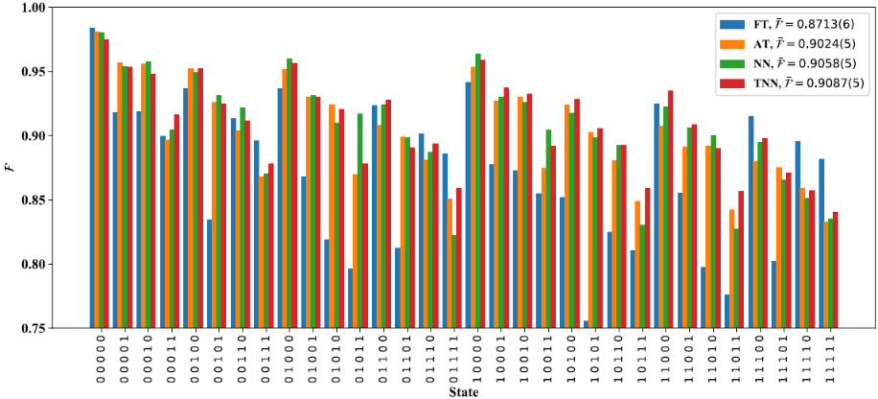
Machine learning based qubit readout
Results – neural net based qubit readout in action

Slide 27
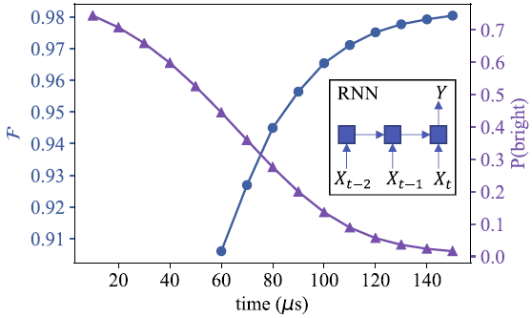
Machine learning based qubit readout
Results – recurrent neural net, feed time-bins one by one
artificial data (1 photon): arrival time interpretation

Slide 28
Quantum machine learning

Slide 29
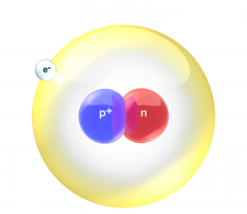
Ground state of the Deuteron nucleus
nuclear binding energy (NIST table): -2.2MeV
3-qubit Hamiltonian (EFT), -2.046MeV:
H3 = 15.531709 I + 0.218291 Z₀ − 6.125 Z₁ − 9.625 Z₂ − 2.143304 X₀ X₁ − 2.143304 Y₀ Y₁ − 3.913119 X₁ X₂ − 3.913119 Y₁ Y₂

Slide 30
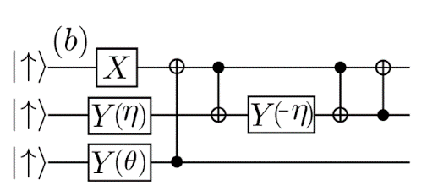
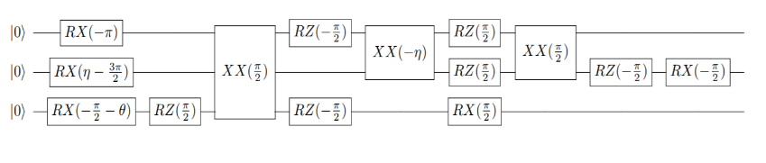
Ground state of the Deuteron nucleus
Canonical 3-qubit UCC ansatz
Dumitrescu, E. F., et al. PRL 120 (2018)

Slide 31
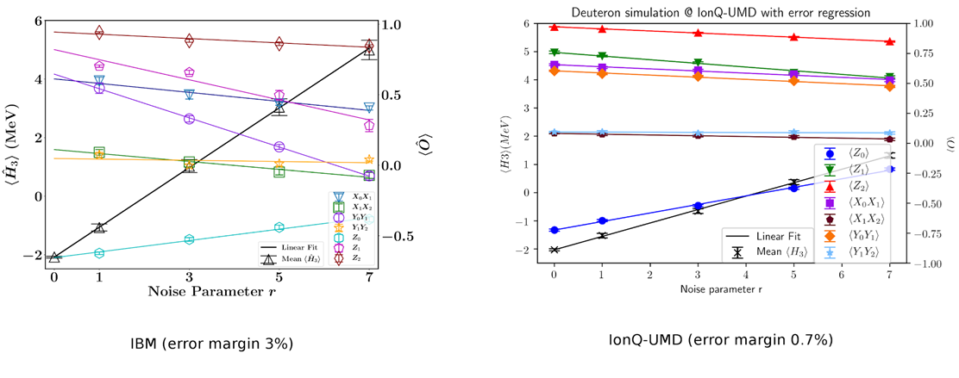
Ground state of the Deuteron nucleus
Zero-noise extrapolation experiment for the (theory-)optimal angles
UMD/IonQ: error margin 0.8(3)%
Richardson, L. F. Phil. Trans. Roy. Soc. A 210 (1911)
Temme, K. et al. PRL 119 (2017)
Li, Y. PRX 7, 2 (2017)
Dumitrescu, E. F., et al. PRL 120 (2018)

Slide 32

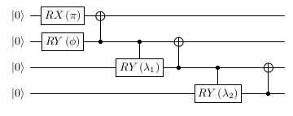
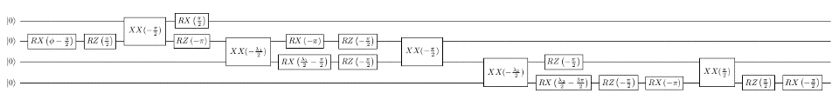
Ground state of the Deuteron nucleus
4-qubit Hamiltonian (EFT), -2.14MeV:
Canonical 4-qubit UCC ansatz
Dumitrescu, E. F., et al. PRL 120 (2018)

Slide 33
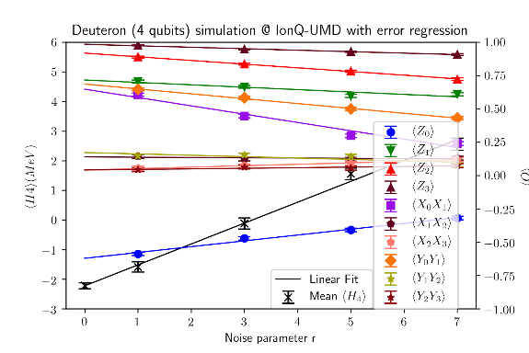
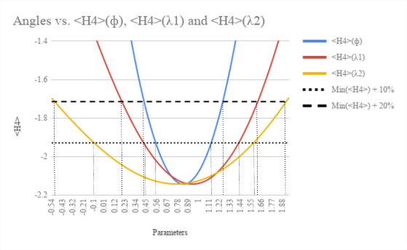
Ground state of the Deuteron
4-qubit theory: -2.14 MeV:
Experimental binding energy value: -2.2(1)MeV
parameter space

Slide 34

Quantum machine learning: Bars and Stripes

Slide 35
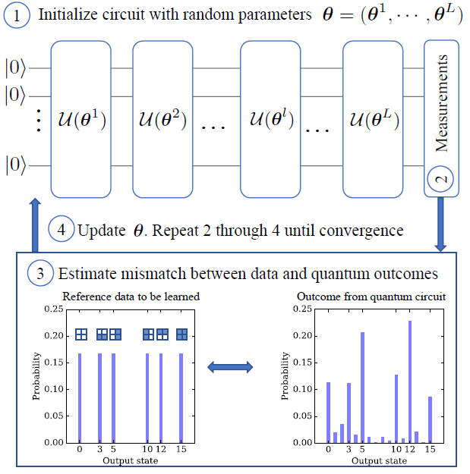
Quantum machine learning: Bars and Stripes
Benedetti, M. et al. arxiv 1801.07686 (2018)

Slide 36
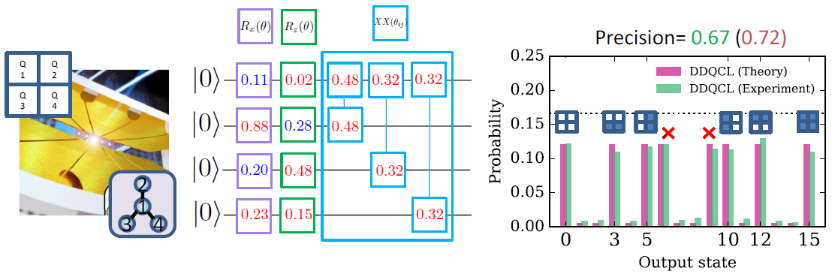
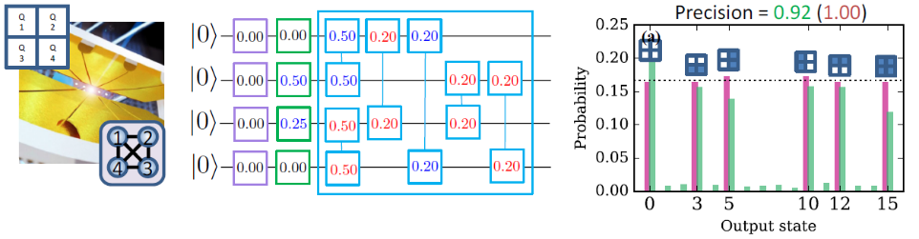
Quantum machine learning: Bars and Stripes
2-Layer star connectivity
2-Layer all-to-all connectivity
Benedetti, M. et al. arxiv 1801.07686 (2018)

Slide 37
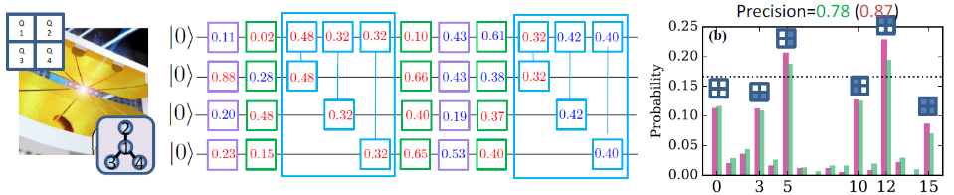
Quantum machine learning: Bars and Stripes
2-Layer star connectivity
4-Layer star connectivity
Benedetti, M. et al. arxiv 1801.07686 (2018)

Slide 38
Quantum machine learning: Bars and Stripes
Benedetti, M. et al. arxiv 1801.07686 (2018)

Slide 39
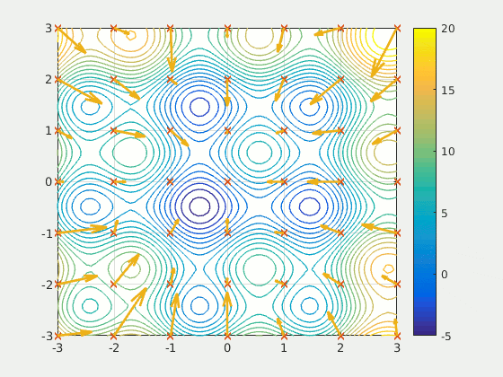
Quantum machine learning: Bars and Stripes
Use Particle Swarm Optimization (PSO)
Animation from Wikipedia by Ephramac

Slide 40
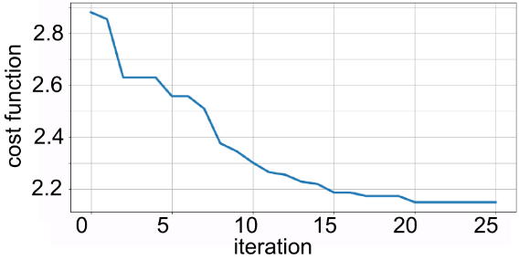
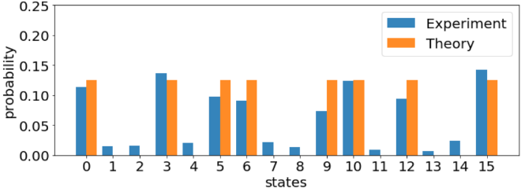
Quantum machine learning: Bars and Stripes
2-Layer star connectivity
Best particle out of 21

Slide 41
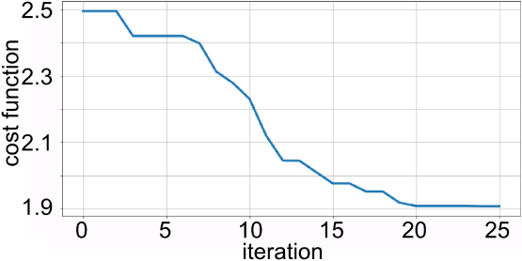
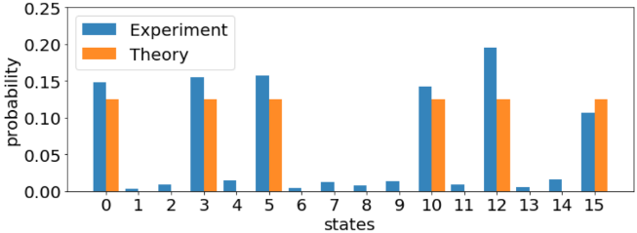
Quantum machine learning: Bars and Stripes
2-Layer all-to-all connectivity
Best particle out of 28

Slide 42
Quantum machine learning: Bars and Stripes
4-Layer star connectivity
Work in progress: 21 parameters, no convergence with PSO

Slide 43

Quantum machine learning: QAOA
Transverse-field Ising model – prepare the (quantum critical) ground state
QAOA– Quantum Approximate Optimization Algorithm
apply H_{xx} and H_{z} (bang-bang = non-adiabatic)
e.g. depth p=2
vary parameters -> minimize energy
W. Ho and T. Hsieh in arXiv:1803.00026 (2018)
Notes:
Also known as the Quantum Alternating Operator Ansatz

Slide 44

Quantum machine learning: QAOA
QAOA– circuit block, can reach exact value (-8.8) with p=3

Slide 45

Quantum machine learning: QAOA
p=2 (start from theoretical optimum)

Slide 46

Quantum machine learning: QAOA
p=1 (start from random value), minimum -8.4

Slide 47
Outlook 1: the future - scaling up
no system will be fully connected for large N
the compilation challenge
D. Kielpinski et al., Nature 417 (2002)
C. Monroe et al., Phys. Rev. A 89 (2014)
D. Hucul, et al., Nature Phys. 11 (2015)

Slide 48













Outlook 2: control over ~20 qubits
Kristin Beck
Marko Cetina
Michael Goldman
0.5 m
Laird Egan

Slide 49















Shantanu
Debnath
Kevin
Landsman
NML
Caroline
Figgatt
Daiwei
Zhu
Chris Monroe
Marcello
Benedetti
(UCL)
M. Hafezi
(JQI)
Alireza Seif
(JQI)
Alejandro
Perdomo-Ortiz
(NASA)
Sonika Johri
(Intel)
Tim Hsieh
(Perimeter)
Omar Shehab
(IonQ)
Yunseong Nam
(IonQ)
Notes:
I thank my advisor, Chris Monroe, and my lab mates, as well as the rest of our group and thank you for your attention.

